Slide 1
Google Data Analytics Capstone
By Paul Butler
2/26/2026

Slide 2
Table of Contents
What is our scenario? 3
Ask: What is the issue we are trying to solve? 4
Analyze: What does our data tell us? 5
Share: What are our results? 6 - 12
Share: What are the key takeaways from our visuals? 13
Act: What should we do? 14

Slide 3
What is our scenario?
Cyclistic is a bike-share company in Chicago.
We want to help Cyclistic maximize the number of annual memberships.
We want to help them understand where Casual and Member riders differ and why.

Slide 4
Ask: What is the issue we are trying to solve?
We want to know how Casual and Member riders differ and why.
Our stakeholders include our director of marketing, analytics team and executives.
Our business task is to find the Member and Casual differences.

Slide 5
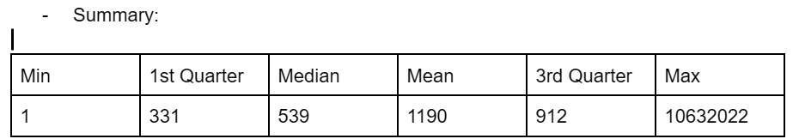
Analyze: What does our data tell us?
Data Cleaning Steps
Performed Data Analysis on both Google Sheets and RStudio
Initial Summary

Slide 6
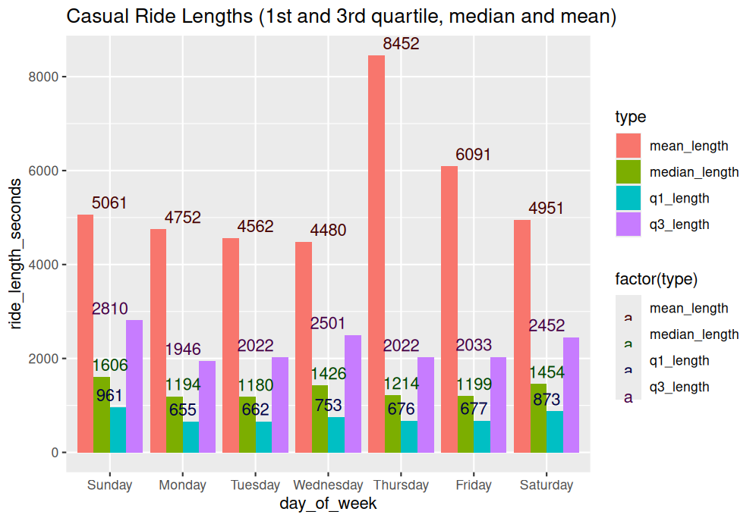
Graph 1: Casual Ride Lengths 1
How long do Casual riders typically use their bikes on a given day?
Discrepancy between the mean and the majority.
Majority of riders come from the weekends.

Slide 7
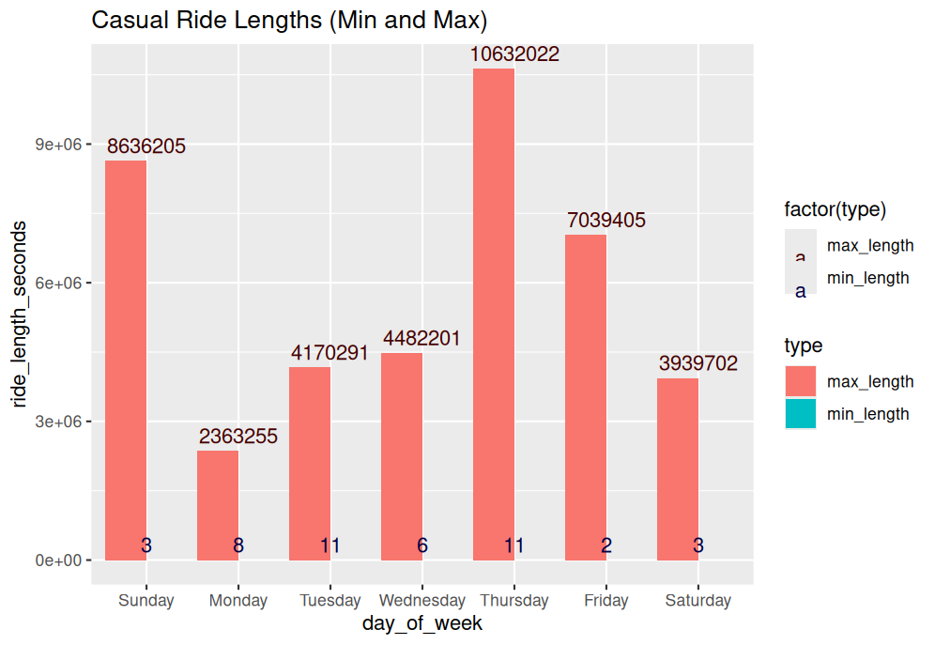
Graph 2: Casual Ride Lengths 2
The extents of how long Casuals will ride for on a given day.
Thursday’s average is being carried by a few high data points.
Most likely more high data points for Thursday.
Extremely high high points, inconsistent low points.

Slide 8
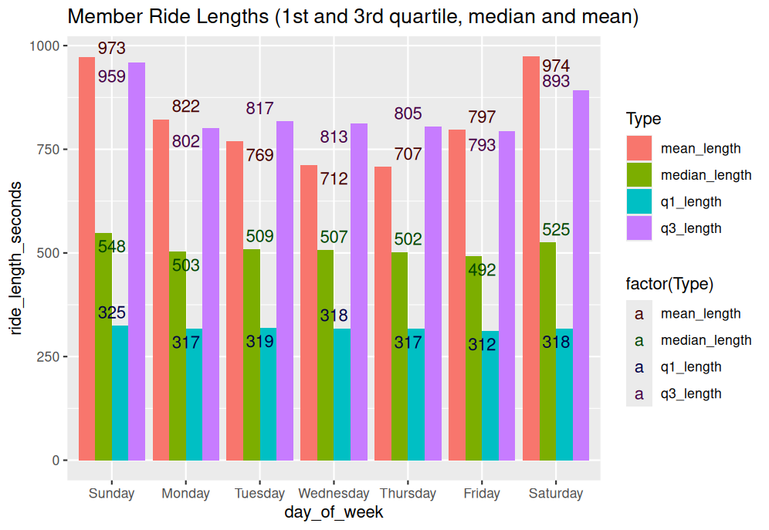
Graph 3: Member Ride Lengths 1
How long do Member riders typically use their bikes on a given day?
Daily averages are consistent with the quartiles and median.
Members ride for longer on the weekends.
Ride their bikes for less time than Casuals, even when regarding inflated averages for the latter.

Slide 9
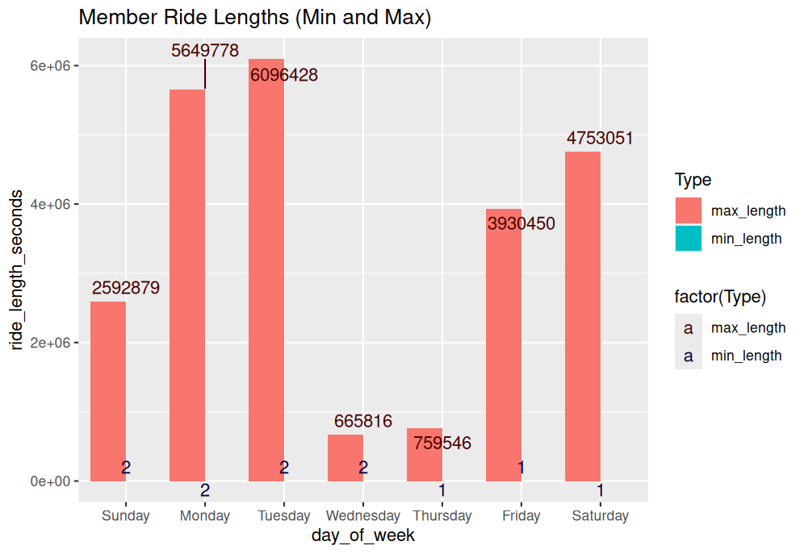
Graph 4: Member Ride Lengths 2
The extents of how long Casuals will ride for on a given day.
High points aren’t as reflective on the averages than Casuals were.
Lower high and low points than Casuals.

Slide 10
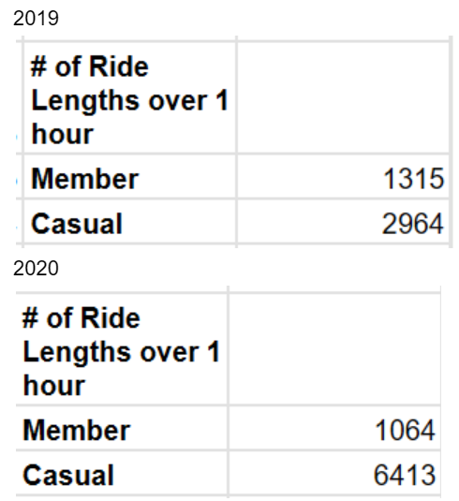
Extra: # of Rides Over 1 Hour
How often does either demographic go for over an hour?
There are many more long Casual rides than Member ones.
Remember, the overall average ride length was just 20 minutes.

Slide 11
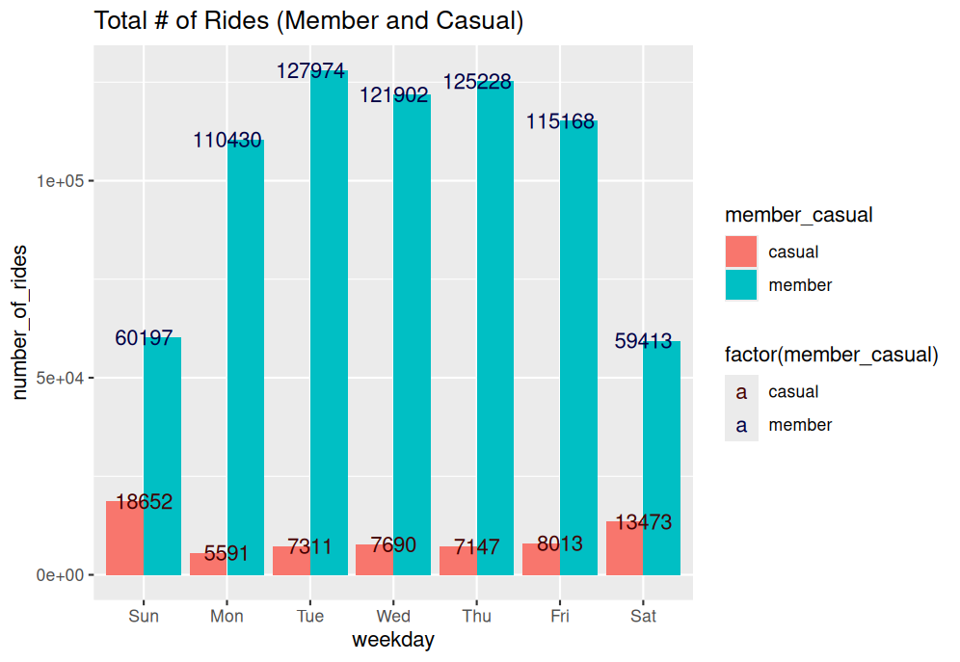
Graph 5: Comparison - # of Rides
How many Member and Casual rides were on a given day.
Many more Member rides.
Casual riders are frequent on the weekends.

Slide 12
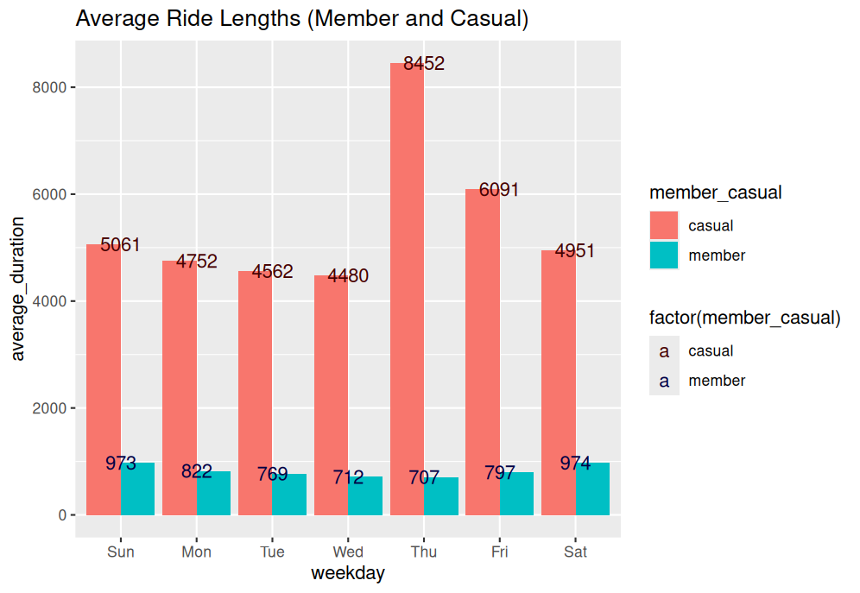
Graph 6: Comparison - Ride length average
How long do Members and Casuals average on a daily basis?
Despite inflated averages, Casuals and Members both seem to have high points on the weekends.

Slide 13
Share: What are the key takeaways from our visuals?
Artificial inflation of Casual ride averages.
Members prefer to use their bikes on the weekday, whereas Casuals ride on the weekends.
Casual riders like to get their money’s worth out of every bike ride.
Both ride for long periods on the weekends.

Slide 14
Act: What should we do?
Limit how long Casual riders can use their bikes for.
Weekend events for both Casual and Member riders.
Bike period license to have multiple rides over a period of time.
Conduct further research as to why each group prefers their method of payments.

Slide 15
Thank you for watching my presentation!
Are there any questions or concerns?

